Slide 1
Data Practicum I Suresh Kumar Dontha
TEXAS Accidents Data Analysis and Visualization

Slide 2
Content
Data collection
Exploratory data analysis
Visualizations
Time series Analysis
Linear Regression
K Nearest Neighbor
References

Slide 3
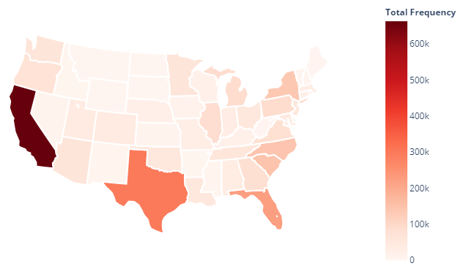

Data Collection
Kaggle – US Accidents Data (3.0 Million Observations) – with 49 variables – 1GB Size.
It is US Countrywide Traffic Accident Dataset (2016 – 2019)
Extracted the Texas State data from the original dataset (~300K Observation)
33 Variables (excluded unnecessary variables from original source)
60 MB File data.
https://www.kaggle.com/sobhanmoosavi/us-accidents
https://smoosavi.org/datasets/us_accidents

Slide 4
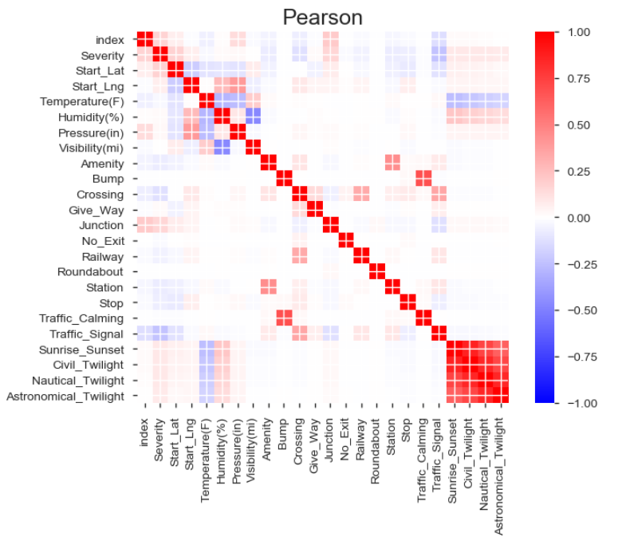

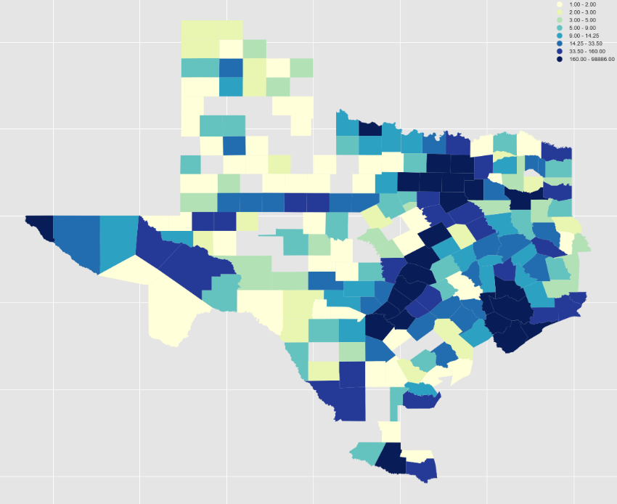

EDA and Choropleth Map of the Accidents Data

Slide 5
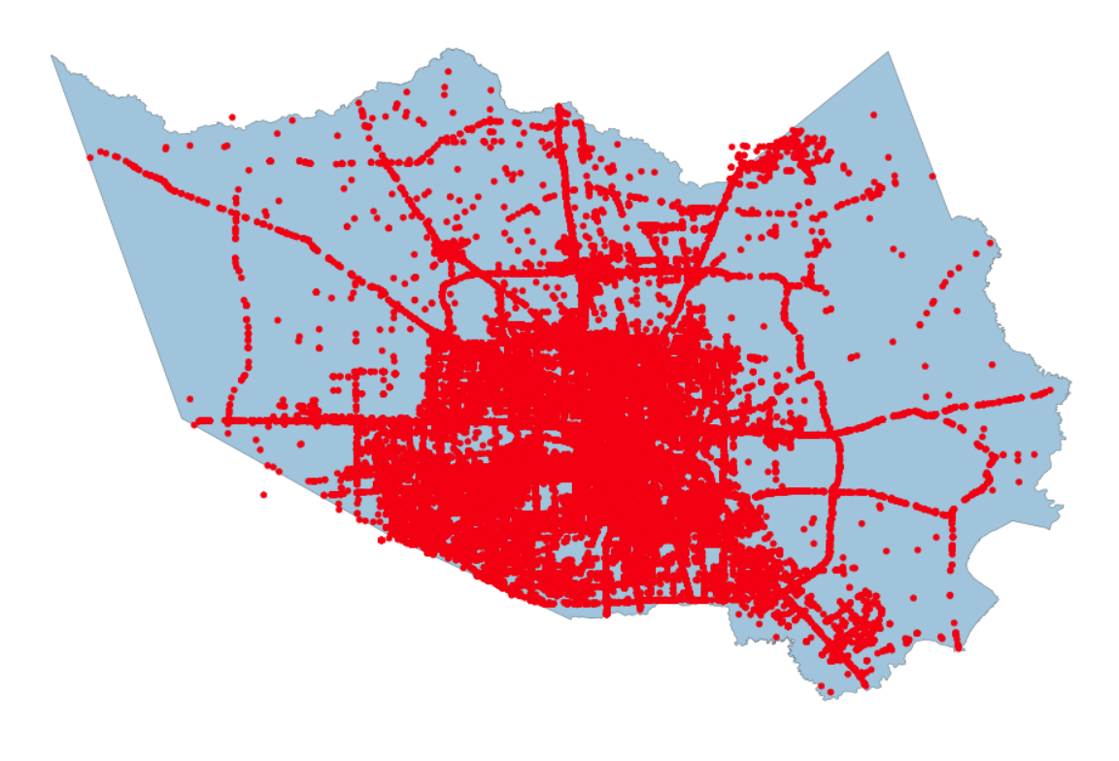

Shapefile and Accident points (geocodes)
Texas state shapefile by county
Texas Accident data has 213 counties data
Any where from 1 to 98886 Accidents
Harris County – 98886 accidents
Dallas County – 68063 accidents
Travis County – 63509 accidents

Slide 6
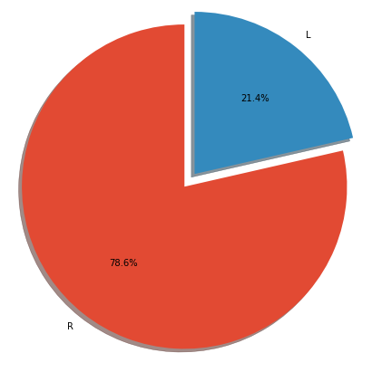
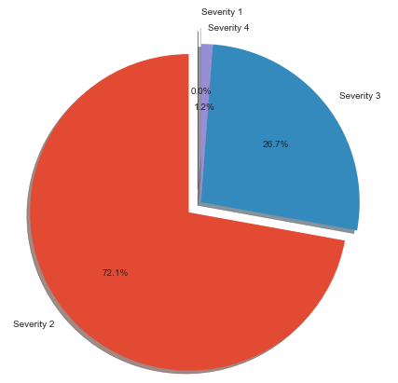
Pie charts
Accident sides L- Left and R-Right side of the road
Accident severity from 1 to 4.
Pie charts displays the percentage of accidents occurred Left or Right side of the road and second pie Chart shows
the percentage of accident severity.
https://machinelearningmastery.com/decompose-time-series-data-trend-seasonality/

Slide 7
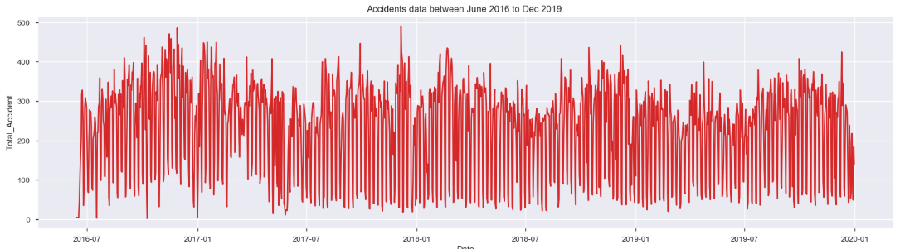
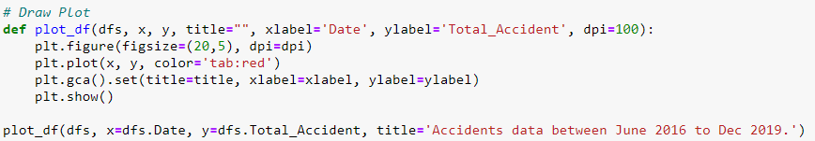
Accidents Data Timeline
Time series graphs can be used to visualize trends in counts or numerical values over time. Because date and time information is continuous categorical data (expressed as a range of values), points are plotted along the x-axis and connected by a continuous line.

Slide 8
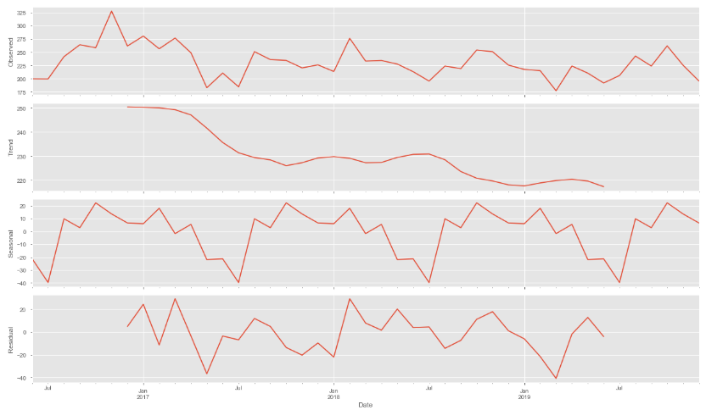
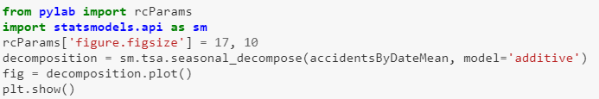
Time Series Decomposition
Time series is sequence of numerical data points successive order. In investing a time series tracks the movement of the chosen data points, such as accidents data over a specified period of time with data points recorded at regular intervals. The additive decomposition is the most appropriate if the magnitude of the seasonal fluctuations, or the variation around the trend-cycle, does not vary with the level of the time series.
Trend → a general systematic linear or (most often) nonlinear component that changes over time and does not repeat Seasonality → a general systematic linear or (most often) nonlinear component that changes over time and does repeat
Residual → errors themselves form a time series that can have temporal structure. A simple autoregression model of this structure can be used to predict the forecast error, which in turn can be used to correct forecasts. This type of model is called a moving average model, the same name but very different from moving average smoothing.
Visualize the data using time-series decomposition that allows us to decompose our time series into three distinct components: trend, seasonality, and noise.

Slide 9
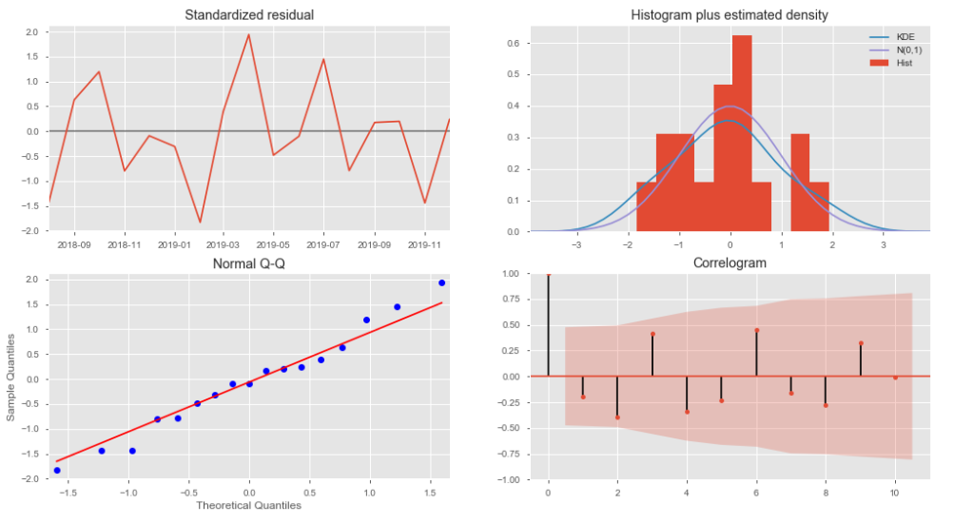
Accident Data - Plot Diagnostics
→ The standardized residual is a measure of the strength of the difference between observed and expected values. The difference between the observed count and the expected count and the standard deviation of the expected count in chi-square testing.
→ The Q-Q plot, or quantile-quantile plot, is a graphical tool to help us assess if a set of data plausibly came from some theoretical distribution such as a Normal or exponential. For example, if we run a statistical analysis that assumes our dependent variable is Normally distributed, we can use a Normal Q-Q plot to check that assumption.
→ A correlogram (also called Auto Correlation Function ACF Plot or Autocorrelation plot) is a visual way to show serial correlation in data that changes over time (i.e. time series data).
→ Kernel density estimation (KDE) is a non-parametric way to estimate the probability density function of a random variable. Kernel density estimation is a fundamental data smoothing problem where inferences about the population are made, based on a finite data sample.

Slide 10
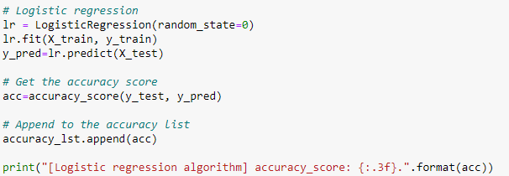
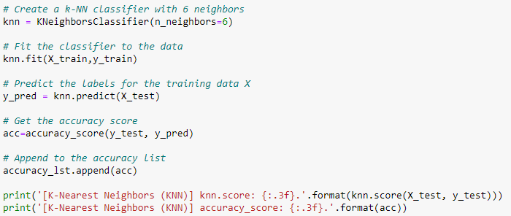

Logistic regression
→ Logistic regression was applied to accident-related data collected from Accident data in order to examine the contribution of several variables to accident severity. It predicted 87% with accuracy for the test data.
k-nearest neighbors
→ Neighbors-based classification is a type of instance-based learning or non-generalizing learning: it does not attempt to construct a general internal model, but simply stores instances of the training data. Classification is computed from a simple majority vote of the nearest neighbors of each point: a query point is assigned the data class which has the most representatives within the nearest neighbors of the point. It predicted 78% with accuracy for the test data.

Slide 11
References:
• US Accidents (3.0 million records)
https://www.kaggle.com/sobhanmoosavi/us-accidents#US_Accidents_Dec19.csv
• A Countrywide Traffic Accident Dataset∗
https://arxiv.org/pdf/1906.05409.pdf
• Accident Risk Prediction based on Heterogeneous Sparse Data: New Dataset and Insights
https://arxiv.org/pdf/1909.09638.pdf
How You Can Avoid Car Accident in 2020
https://medium.com/@RonghuiZhou/how-you-can-avoid-car-accident-in-2020-c9626c9b6f68

